Slide 1

Ari Kurniawan
www.arikurniawan.com

Slide 2
Memulai Flutter
PS D:\ngajar\Pemrograman Mobile\project> flutter --version
Flutter 1.20.4 • channel stable • https://github.com/flutter/flutter.git
Framework • revision fba99f6cf9 (4 weeks ago) • 2020-09-14 15:32:52 -0700
Engine • revision d1bc06f032
Tools • Dart 2.9.2
PS D:\ngajar\Pemrograman Mobile\project\halo1> flutter doctor
Doctor summary (to see all details, run flutter doctor -v):
[√] Flutter (Channel stable, 1.20.4, on Microsoft Windows [Version 10.0.18362.1082], locale id-ID)
[√] Android toolchain - develop for Android devices (Android SDK version 30.0.2)
[√] Android Studio (version 4.0)
[√] VS Code (version 1.50.0)
[!] Connected device
! No devices available
! Doctor found issues in 1 category.
PS D:\ngajar\Pemrograman Mobile\project\halo1> flutter run
No supported devices connected.

Slide 3
Membuat Project Baru
PS D:\ngajar\Pemrograman Mobile\project> flutter create halo1
Creating project halo1...
halo1\.gitignore (created)
halo1\.idea\libraries\Dart_SDK.xml (created)
halo1\.idea\libraries\KotlinJavaRuntime.xml (created)
halo1\.idea\modules.xml (created)
halo1\.idea\runConfigurations\main_dart.xml (created)
....
halo1\README.md (created)
halo1\test\widget_test.dart (created)
Running "flutter pub get" in halo1... 2,5s
Wrote 71 files.
All done!
[√] Flutter: is fully installed. (Channel stable, 1.20.4, on Microsoft Windows [Version 10.0.18362.1082], locale id-ID)
[√] Android toolchain - develop for Android devices: is fully installed. (Android SDK version 30.0.2)
[√] Android Studio: is fully installed. (version 4.0)
[√] VS Code: is fully installed. (version 1.50.0)
[!] Connected device: is not available.
Run "flutter doctor" for information about installing additional components.
In order to run your application, type:
$ cd halo1
$ flutter run
Your application code is in halo1\lib\main.dart.

Slide 4
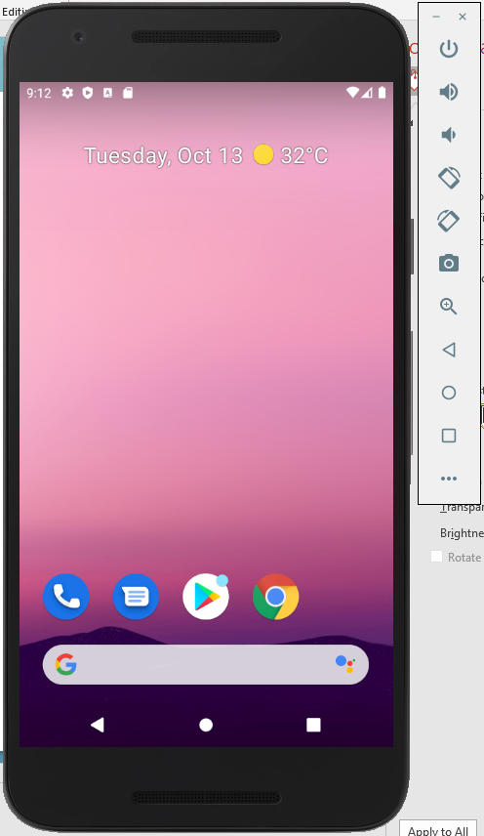
Emulator
PS D:\ngajar\Pemrograman Mobile\project> flutter emulators
4 available emulators:
Nexus_5X_API_30 • Nexus 5X API 30 • Google • android
flutter_emulator • flutter emulator • Google • android
flutter_emulator_2 • flutter emulator 2 • Google • android
flutter_emulator_3 • flutter emulator 3 • Google • android
To run an emulator, run 'flutter emulators --launch <emulator id>'.
To create a new emulator, run 'flutter emulators --create [--name xyz]'.
You can find more information on managing emulators at the links below:
https://developer.android.com/studio/run/managing-avds
https://developer.android.com/studio/command-line/avdmanager
PS D:\ngajar\Pemrograman Mobile\project\halo1> flutter emulators --launch Nexus_5X_API_30
PS D:\ngajar\Pemrograman Mobile\project> flutter devices
1 connected device:
sdk gphone x86 (mobile) • emulator-5554 • android-x86 • Android 11 (API 30) (emulator)

Slide 5
Membuat Emulator Baru
PS D:\ngajar\Pemrograman Mobile\project> flutter emulators --create --name soboteika_emulator
Emulator 'soboteika_emulator' created successfully.
PS D:\ngajar\Pemrograman Mobile\project> flutter emulators
5 available emulators:
Nexus_5X_API_30 • Nexus 5X API 30 • Google • android
flutter_emulator • flutter emulator • Google • android
flutter_emulator_2 • flutter emulator 2 • Google • android
flutter_emulator_3 • flutter emulator 3 • Google • android
soboteika_emulator • soboteika emulator • Google • android
To run an emulator, run 'flutter emulators --launch <emulator id>'.
To create a new emulator, run 'flutter emulators --create [--name xyz]'.
You can find more information on managing emulators at the links below:
https://developer.android.com/studio/run/managing-avds
https://developer.android.com/studio/command-line/avdmanager

Slide 6
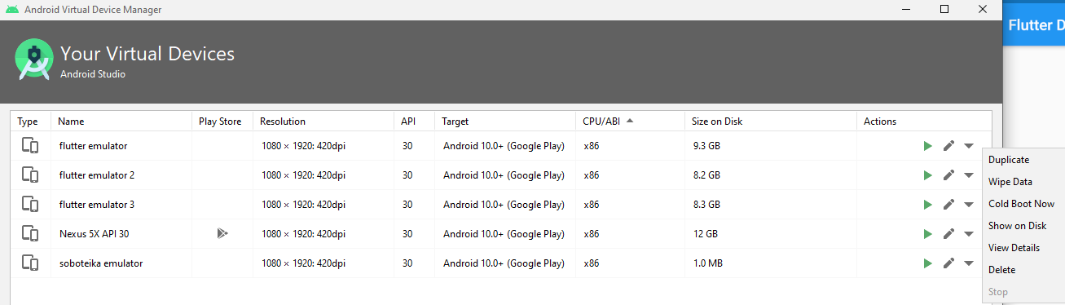
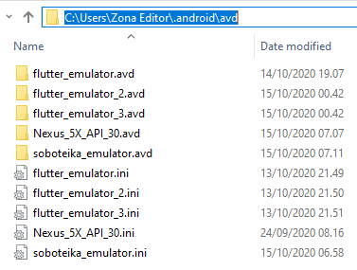
AVDM

Slide 7
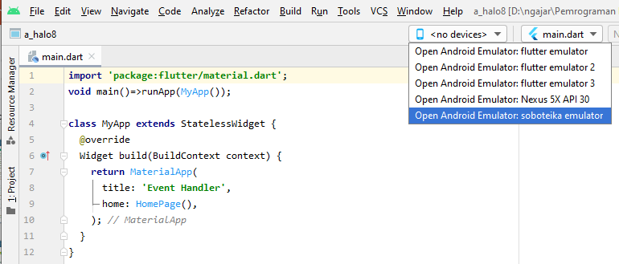
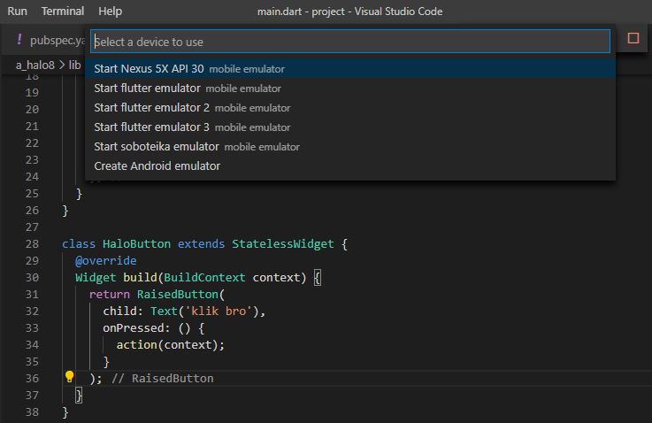
Emulator pada Editor
Android Studio
Visual Studio Code

Slide 8
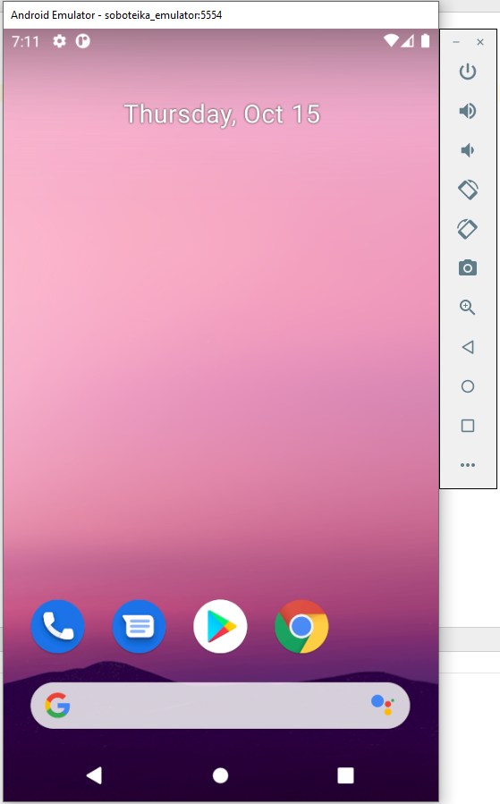
Emulator
soboteika_emulator
Nexus_5X_API_30

Slide 9
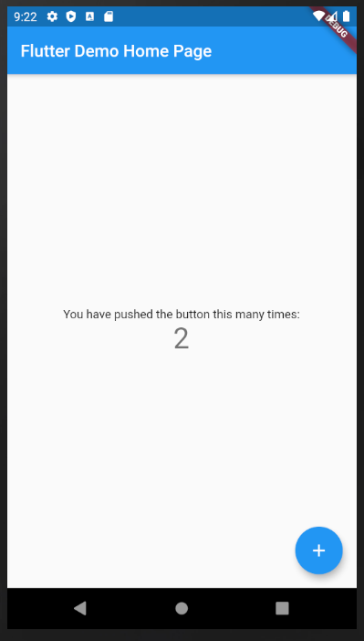
PS D:\ngajar\Pemrograman Mobile\project\halo1> flutter run
Using hardware rendering with device sdk gphone x86. If you notice graphics artifacts, consider enabling software rendering with "--enable-software-rendering".
Launching lib\main.dart on sdk gphone x86 in debug mode...
Running Gradle task 'assembleDebug'...
Parameter format not correct -
Running Gradle task 'assembleDebug'...
Running Gradle task 'assembleDebug'... Done 219,9s (!)
√ Built build\app\outputs\flutter-apk\app-debug.apk.
Installing build\app\outputs\flutter-apk\app.apk... 8,3s
Waiting for sdk gphone x86 to report its views... 12ms
I/Choreographer(11210): Skipped 79 frames! The application may be doing too much work on its main thread.
Syncing files to device sdk gphone x86...
2.527ms (!)
Flutter run key commands.
r Hot reload.
R Hot restart.
h Repeat this help message.
d Detach (terminate "flutter run" but leave application running).
c Clear the screen
q Quit (terminate the application on the device).
An Observatory debugger and profiler on sdk gphone x86 is available at: http://127.0.0.1:57733/FC9QD_UL0eE=/

Slide 10
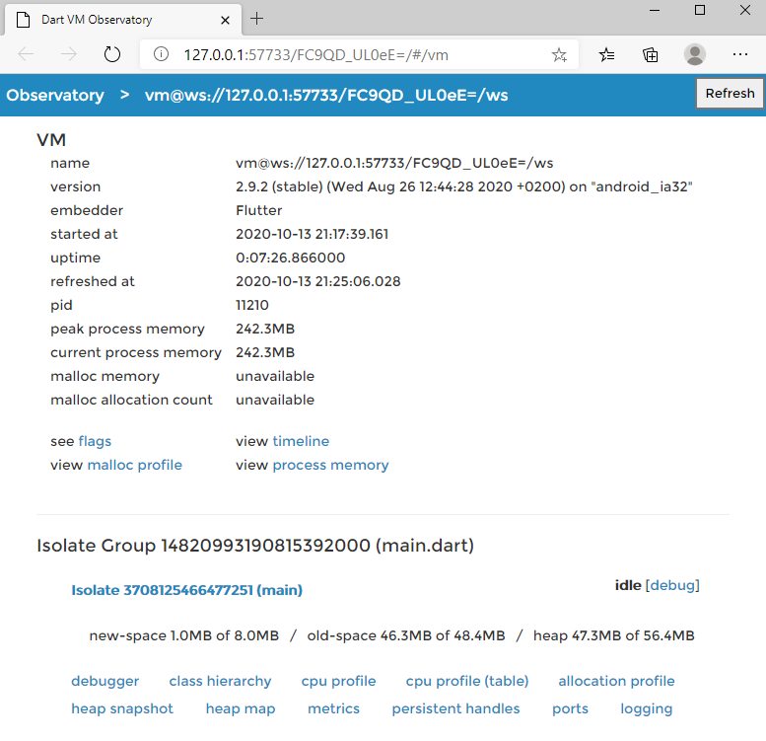

Slide 11
Flutter Run Key Commands
Flutter run key commands.
r Hot reload.
R Hot restart.
h Repeat this help message.
d Detach (terminate "flutter run" but leave application running).
c Clear the screen
q Quit (terminate the application on the device).
s Save a screenshot to flutter.png.
b Toggle the platform brightness setting (dark and light mode). (debugBrightnessOverride)w Dump widget hierarchy to the console. (debugDumpApp)t Dump rendering tree to the console. (debugDumpRenderTree)L Dump layer tree to the console. (debugDumpLayerTree)S Dump accessibility tree in traversal order. (debugDumpSemantics)U Dump accessibility tree in inverse hit test order. (debugDumpSemantics)i Toggle widget inspector. (WidgetsApp.showWidgetInspectorOverride)p Toggle the display of construction lines. (debugPaintSizeEnabled)o Simulate different operating systems. (defaultTargetPlatform)z Toggle elevation checker.
g Run source code generators.
M Write SkSL shaders to a unique file in the project directory.
v Launch DevTools.
P Toggle performance overlay. (WidgetsApp.showPerformanceOverlay)a Toggle timeline events for all widget build methods. (debugProfileWidgetBuilds)An Observatory debugger and profiler on sdk gphone x86 is available at: http://127.0.0.1:57733/FC9QD_UL0eE=/

Slide 12
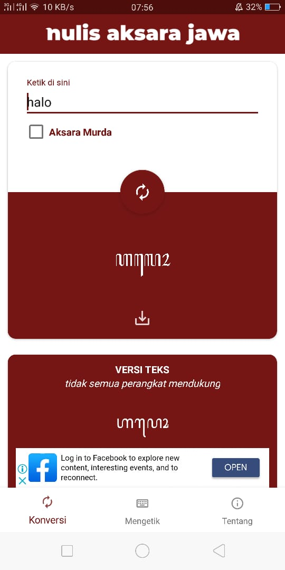
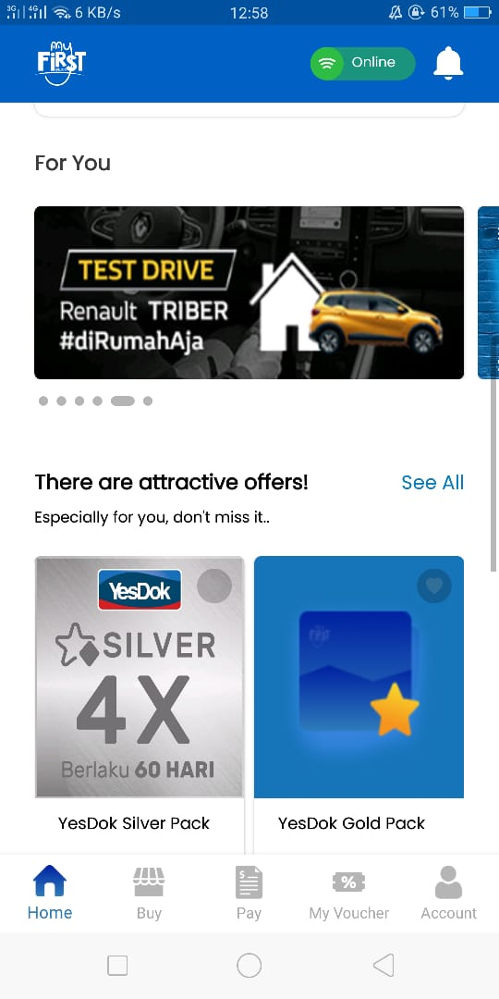
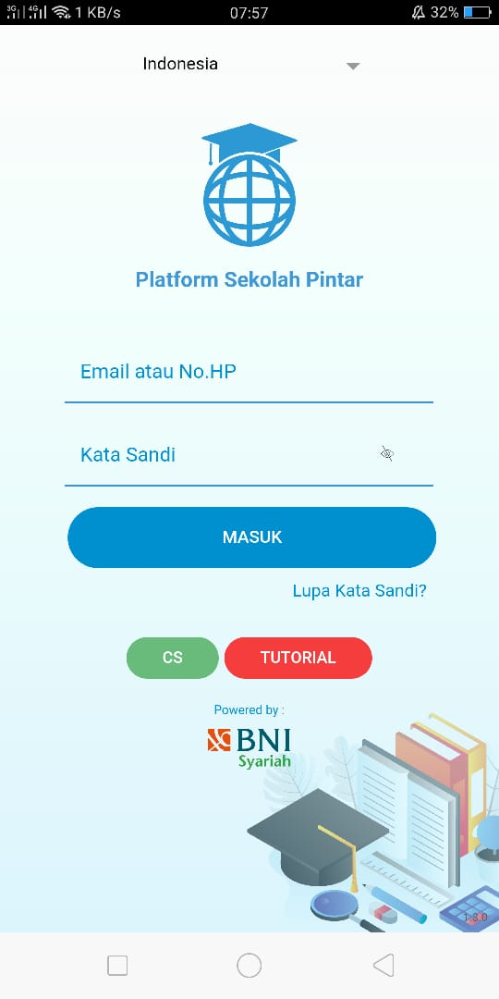
Aplikasi Mobile

Slide 13
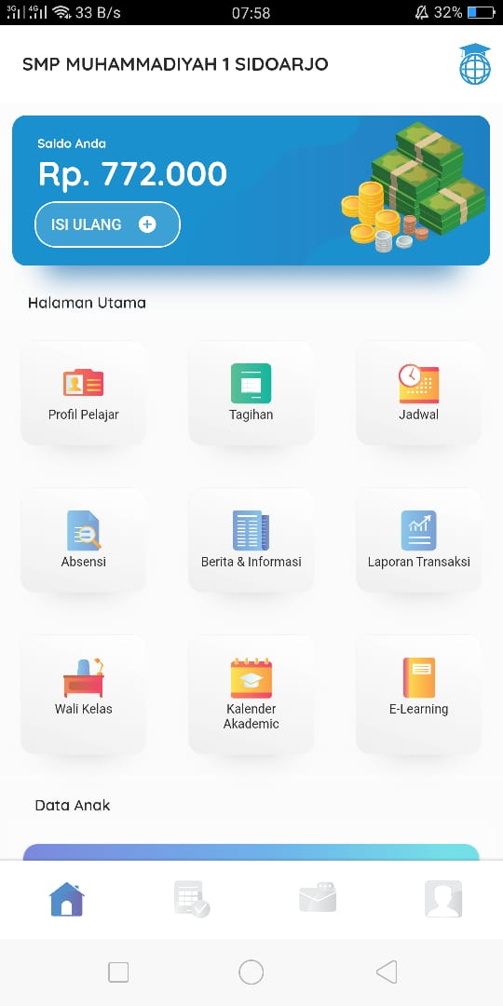
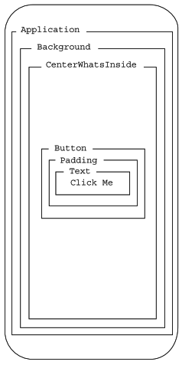
Aplikasi Mobile - Flutter
Widgets within widgets

Slide 14
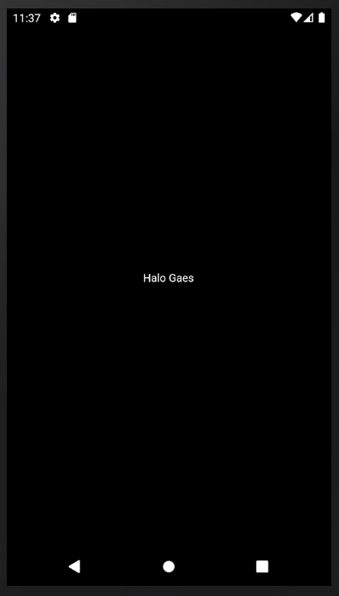
Flutter: Aplikasi
Menampilkan Teks
import 'package:flutter/material.dart';
void main() {
runApp(
Center(
child: Text(
'Halo Gaes',
textDirection: TextDirection.ltr,
)
)
);
}

Slide 15
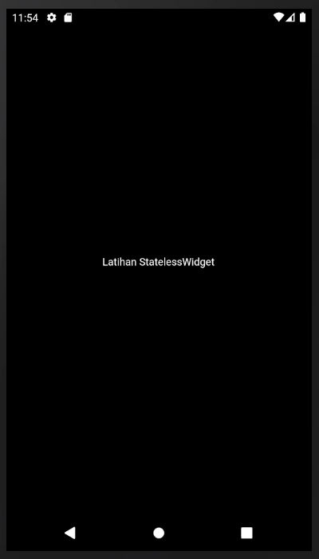
Flutter: Aplikasi
StatelessWidget
import 'package:flutter/material.dart';
void main()=>runApp(HaloApp());
class HaloApp extends StatelessWidget {
@override
Widget build(BuildContext context) {
return Center (
child: Text(
'Latihan StatelessWidget',
textDirection: TextDirection.ltr
)
);
}
}

Slide 16
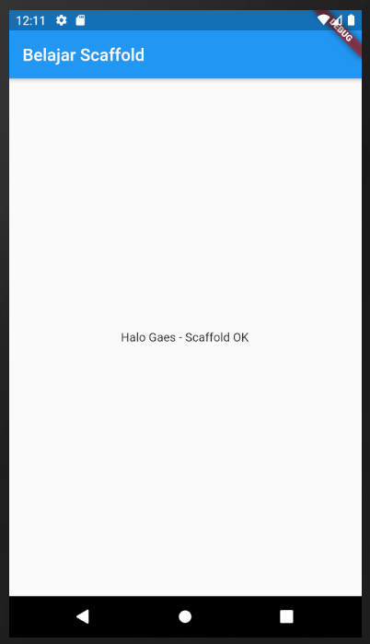
Flutter: Aplikasi
Scaffold
import 'package:flutter/material.dart';
void main()=>runApp(HaloApp());
class HaloApp extends StatelessWidget {
@override
Widget build(BuildContext context) {
return MaterialApp (
title: 'HaloApp: MaterialApp',
theme: ThemeData(
primarySwatch: Colors.blue
),
home: Scaffold(
appBar: AppBar(
title: Text ('Belajar Scaffold'),
),
body: Center(
child: Text(
'Halo Gaes - Scaffold OK',
textDirection: TextDirection.ltr,
)
)
)
);
}
}

Slide 17
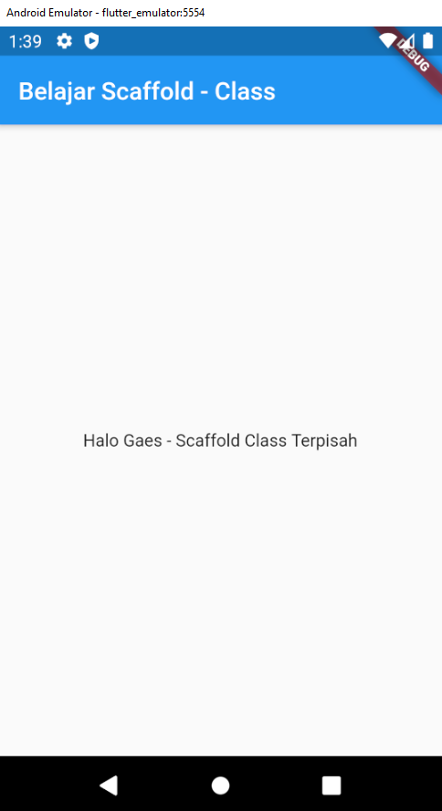
import 'package:flutter/material.dart';
void main()=>runApp(HaloApp());
class HaloApp extends StatelessWidget {
@override
Widget build(BuildContext context) {
return MaterialApp (
title: 'HaloApp: MaterialApp',
theme: ThemeData(
primarySwatch: Colors.blue
),
home: HomePage()
);
}
}
Flutter: Aplikasi
Scaffold Dalam Class
main.dart
class HomePage extends StatelessWidget {
@override
Widget build(BuildContext context) {
return Scaffold(
appBar: AppBar(
title: Text ('Belajar Scaffold - Class'),
),
body: Center(
child: Text(
'Halo Gaes - Scaffold Class Terpisah',
textDirection: TextDirection.ltr,
)
)
);
}
}

Slide 18
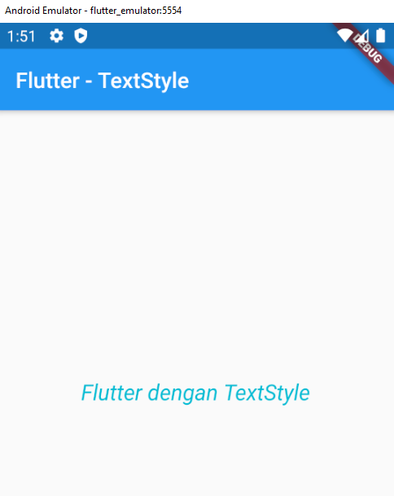
import 'package:flutter/material.dart';
void main()=>runApp(HaloApp());
class HaloApp extends StatelessWidget {
@override
Widget build(BuildContext context) {
return MaterialApp (
title: 'HaloApp: MaterialApp',
theme: ThemeData(
primarySwatch: Colors.blue
),
home: HomePage()
);
}
}
Flutter: Aplikasi
TextStyle
class HomePage extends StatelessWidget {
@override
Widget build(BuildContext context) {
return Scaffold(
appBar: AppBar(
title: Text ('Flutter - TextStyle'),
),
body: Center(
child: Text('Flutter dengan TextStyle',
textDirection: TextDirection.ltr,
style: TextStyle(
fontSize: 20.0,
fontStyle: FontStyle.italic,
color: Colors.cyan,
)
)
)
);
}
}

Slide 19
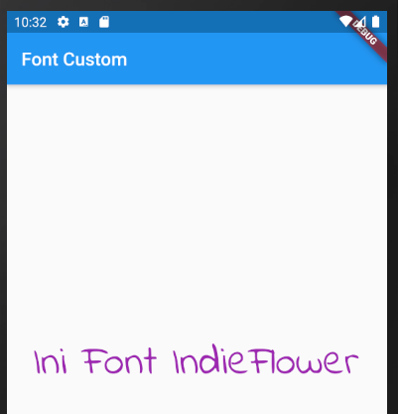
import 'package:flutter/material.dart';
void main() => runApp(HelloApp());
class HelloApp extends StatelessWidget {
@override
Widget build(BuildContext context) {
return MaterialApp(
title: 'Hello',
theme: ThemeData(
primarySwatch: Colors.blue,
),
home: HomePage()
);
}
}
class HomePage extends StatelessWidget {
@override
Widget build(BuildContext context) {
return Scaffold(
appBar: AppBar(
title: Text('Font Custom')
),
body: Center(
child: Text(
'Ini Font IndieFlower',
textDirection: TextDirection.ltr,
style: TextStyle(
fontSize: 30.0,
color: Colors.red,
decoration: TextDecoration.none,
fontFamily: 'IndieFlower',
fontWeight: FontWeight.w400,
)
)
)
);
}
}
Flutter: Aplikasi
Custom Font
Download font di https://fonts.google.com/
Extract, letakkan font (.ttf) di folder /fonts misal: IndieFlower-Regular.ttf
Edit file pubspec.yaml
Jalankan: flutter pub get
# example:
fonts:
- family: IndieFlower
fonts:
- asset: fonts/IndieFlower-Regular.ttf
# - asset: fonts/Schyler-Italic.ttf

Slide 20
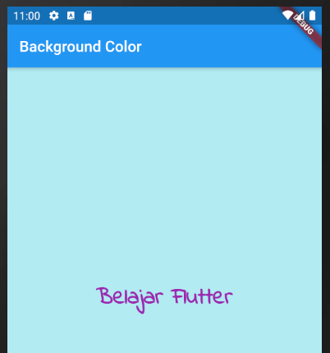
import 'package:flutter/material.dart';
void main() => runApp(HelloApp());
class HelloApp extends StatelessWidget {
@override
Widget build(BuildContext context) {
return MaterialApp(
title: 'Background Color',
theme: ThemeData(
primarySwatch: Colors.blue,
),
home: HomePage()
);
}
}
class HomePage extends StatelessWidget {
@override
Widget build(BuildContext context) {
return Scaffold(
appBar: AppBar(
title: Text('Background Color')
),
body: Material(
color: Colors.cyan[100],
child: Center(
child: Text(
'Belajar Flutter',
textDirection: TextDirection.ltr,
style: TextStyle(
fontSize: 30.0,
color: Colors.purple,
decoration: TextDecoration.none,
fontFamily: 'IndieFlower',
fontWeight: FontWeight.w700,
)
)
)
)
);
}
}
Flutter: Aplikasi
Background Color
Mengatur warna background menggunakan properti color dari kelas Material
Komponen Material dapat dijadikan sebagai nilai properti body dari komponen scaffold

Slide 21
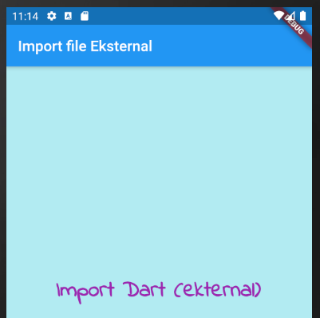
Flutter: Aplikasi
Import File Eksternal
Untuk mengorganisasi file lebih mudah
homepage.dart
main.dart
import 'package:flutter/material.dart';
class HomePage extends StatelessWidget {
@override
Widget build(BuildContext context) {
return Scaffold(
appBar: AppBar(
title: Text('Import file Eksternal')
),
body: Material(
color: Colors.cyan[100],
child: Center(
child: Text(
'Import Dart (ekternal)',
textDirection: TextDirection.ltr,
style: TextStyle(
fontSize: 30.0,
color: Colors.purple,
decoration: TextDecoration.none,
fontFamily: 'IndieFlower',
fontWeight: FontWeight.w700,
)
)
)
)
);
}
}
import 'package:flutter/material.dart';
import './homepage.dart';
void main() => runApp(HelloApp());
class HelloApp extends StatelessWidget {
@override
Widget build(BuildContext context) {
return MaterialApp(
title: 'Background Color',
theme: ThemeData(
primarySwatch: Colors.blue,
),
home: HomePage()
);
}
}

Slide 22
Flutter: Aplikasi
Event Handling
import 'package:flutter/material.dart';
void main()=>runApp(MyApp());
class MyApp extends StatelessWidget {
@override
Widget build(BuildContext context) {
return MaterialApp(
title: 'Event Handler',
home: HomePage(),
);
}
}
class HomePage extends StatelessWidget {
@override
Widget build(BuildContext context) {
return Scaffold(
appBar: AppBar(
title: Text('Event Handler')
),
body: Center(
child: HaloButton(),
)
);
}
}
class HaloButton extends StatelessWidget {
@override
Widget build(BuildContext context) {
return RaisedButton(
child: Text('klik bro'),
onPressed: () {
action(context);
}
);
}
}
void action(BuildContext context) {
var alertDialog = AlertDialog(
title: Text('Event Handling'),
content: Text('Halo mas bro'),
);
showDialog(
context: context,
builder: (BuildContext context) {
return alertDialog;
}
);
}

Slide 23
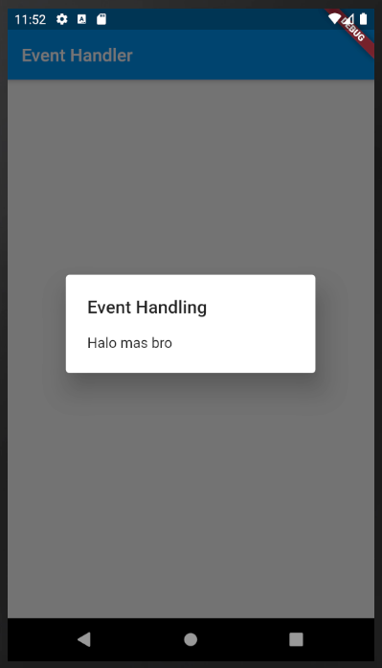
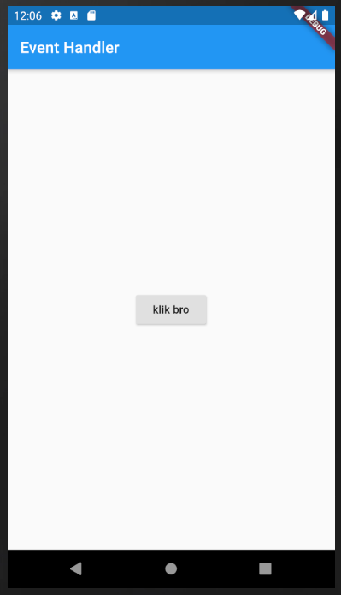
Flutter: Aplikasi

Slide 24
